Slide 1

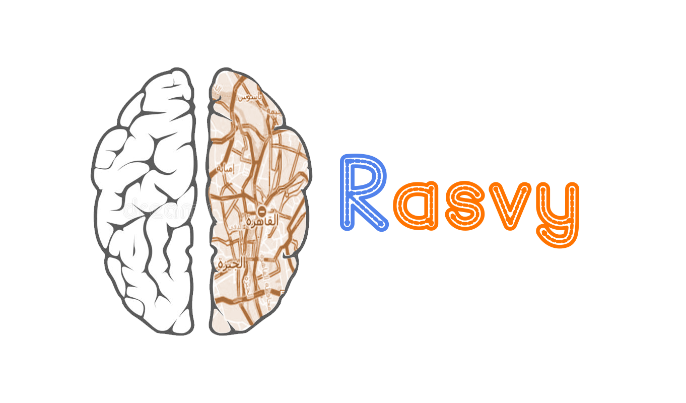
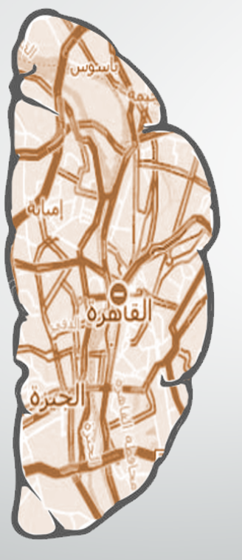

Slide 2
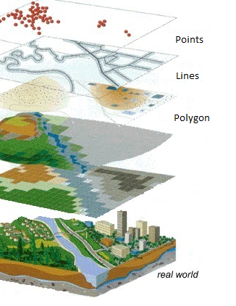
What is GIS ?
an organized integration of hardware, software and geographic data designed to capture, store, edit, analyze, share and display geographically referenced information

Slide 3
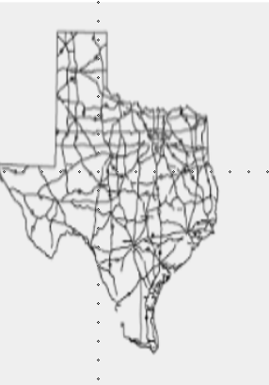
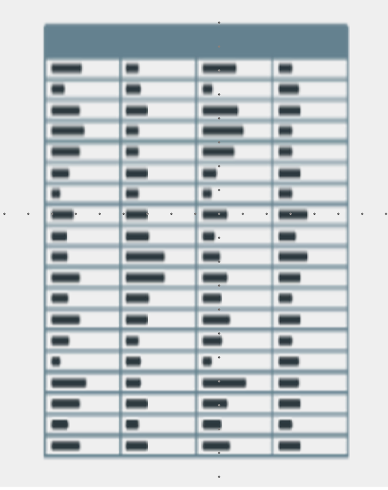
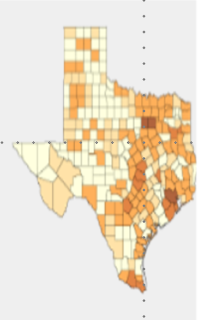
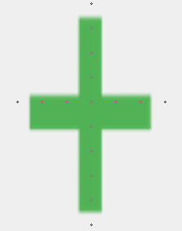

GIS Problem & Solution
GIS Specialists spend a lot of time to convert the map's raster into vector, then proceed with their real task which is insert data into the map's vector.
Maps
Data
GIS
Converting satellite map “ Rasters ” into google map “Vectors ” made a lot easier with a few clicks using our AI GAN-based application

Slide 4

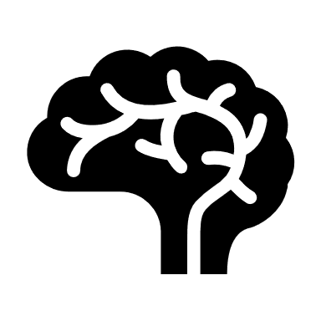

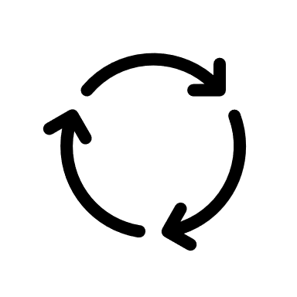

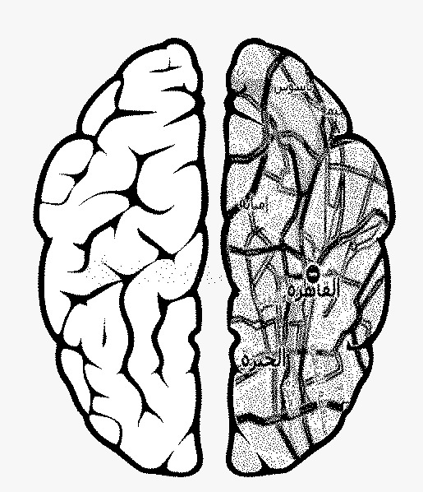
Rasvy Architecture
Preprocessing
Clean, split & compress
Data
Evaluation
Compare the quality of generated image
& expected image
Rasvy app
Use web app to convert satellite image to ERSI shap file online
STEP
02
STEP
04
STEP
06
STEP
01
STEP
03
STEP
05
Data
Collected dataset of satellite & google map images of New Cairo , Egypt
GAN
Implement
and train the model
Polygonize
Convert google map
Image to ESRI Shapefile

Slide 5
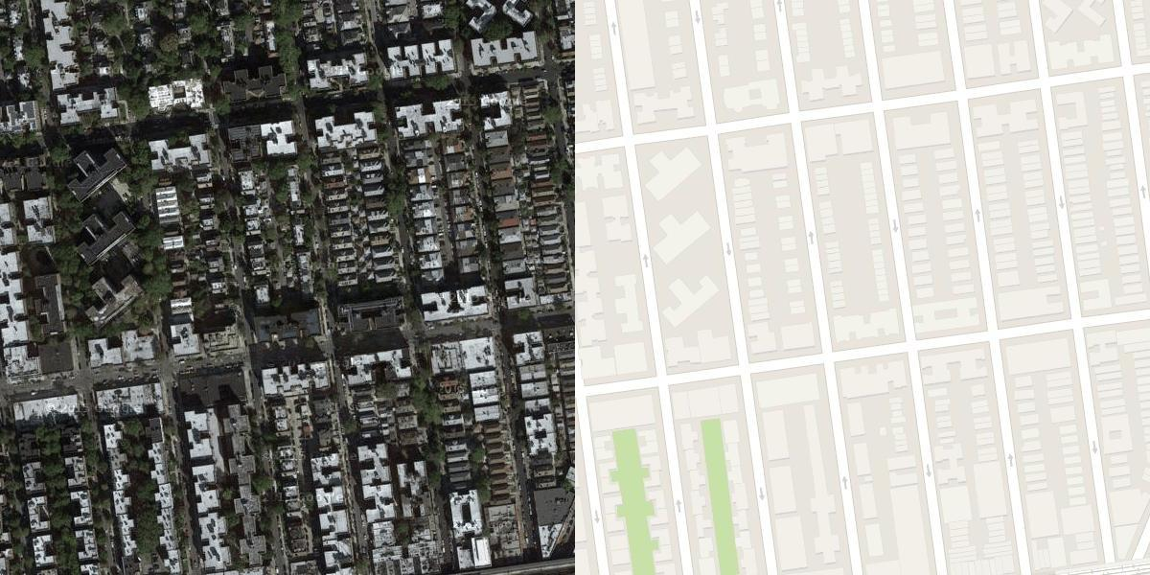
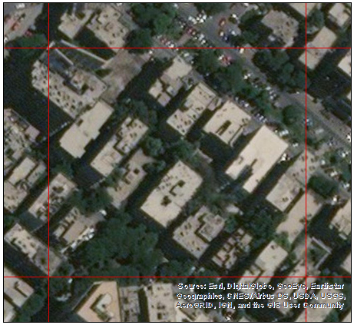
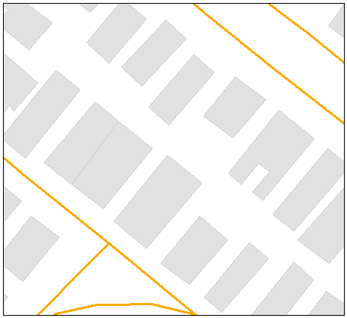
Data
KAGGLE Dataset
STEP
01
RASVY Dataset
General-purpose solution for
image-to-image translation problems
Collected by RASVY team with the help of some GIS specialists from the Central Agency for Public Mobilization and Statistics.
NYC , USA
New Cairo, Egypt
Satellite
Google map
Satellite
Google map

Slide 6
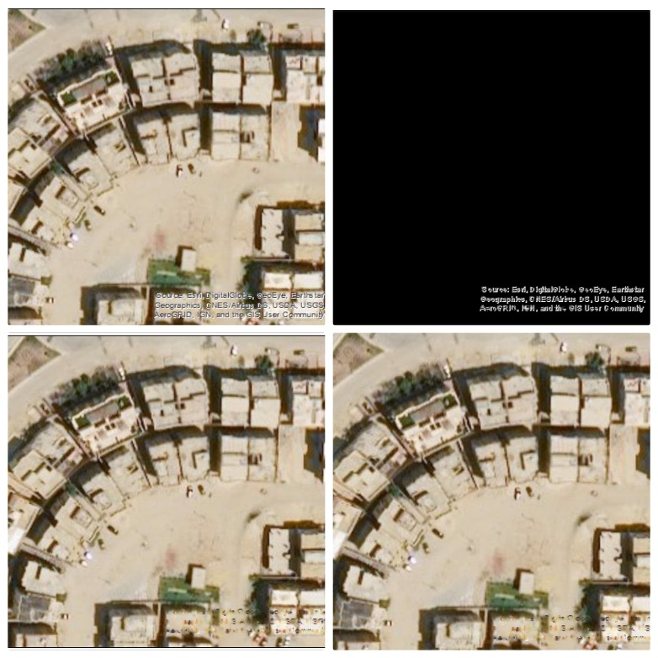
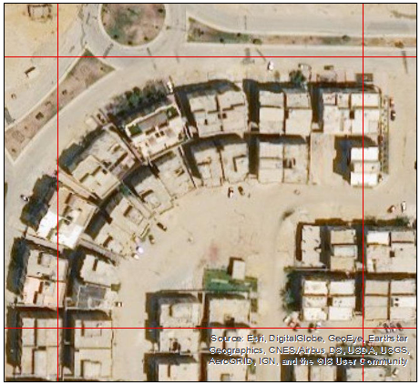
Preprocessing
STEP
02

Slide 7
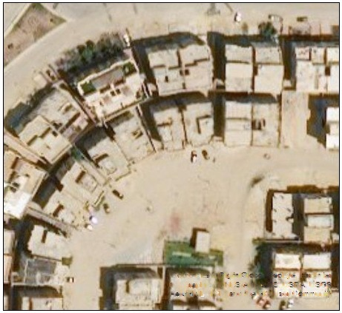
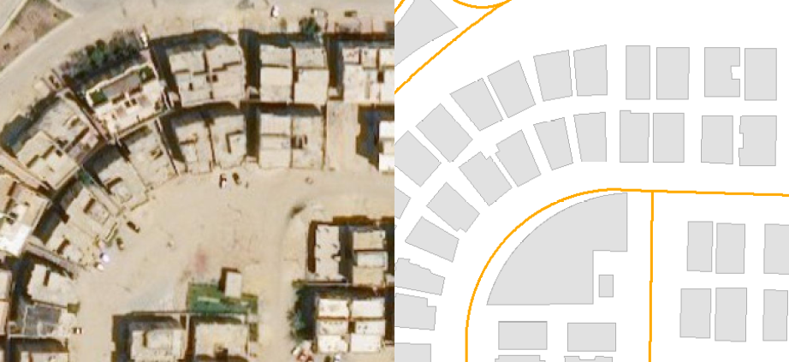
Watermark
Result
Rescale
Crop & Merge
5203 Image
922 * 423
80% train
20% test
Satellite
Google map

Slide 8
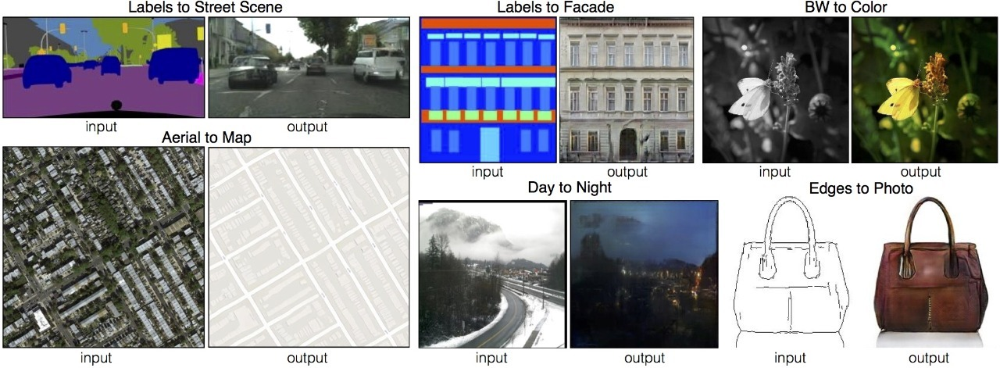
Generative Adversarial Network (GAN)
STEP
03
Algorithmic architectures that use the two neural networks that make up a GAN pitting one against the other (thus the “adversarial”) in order to generate new synthetic instances of data, that referred to as the generator and the discriminator

Slide 9
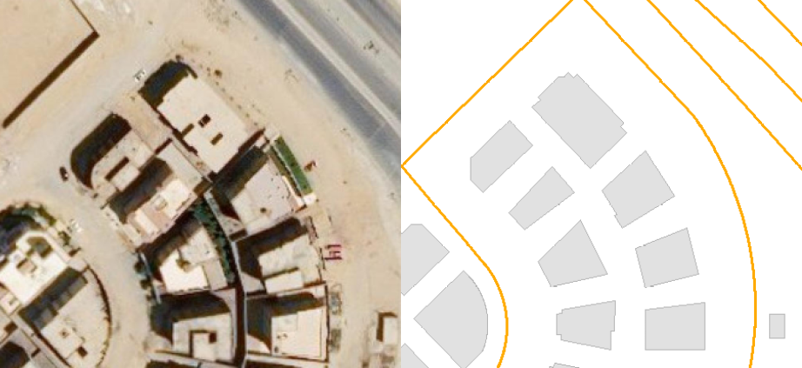
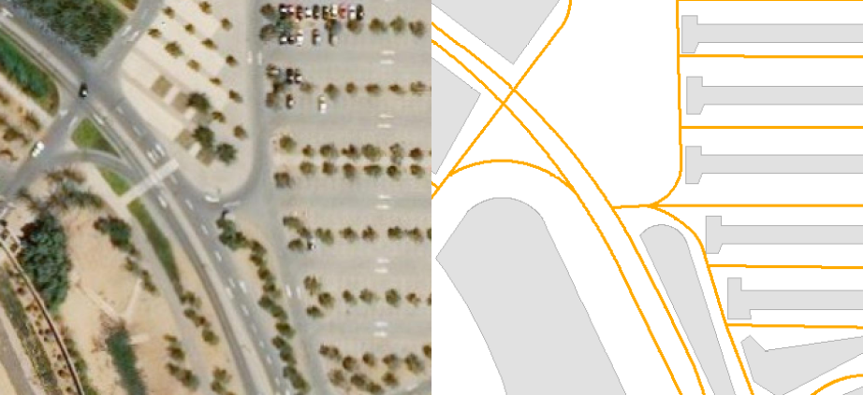
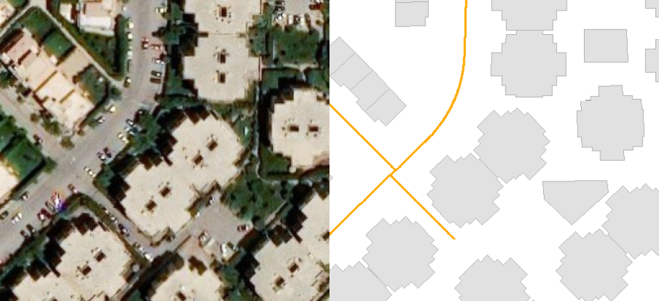
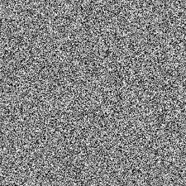
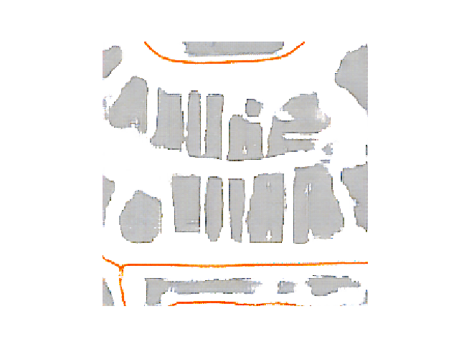
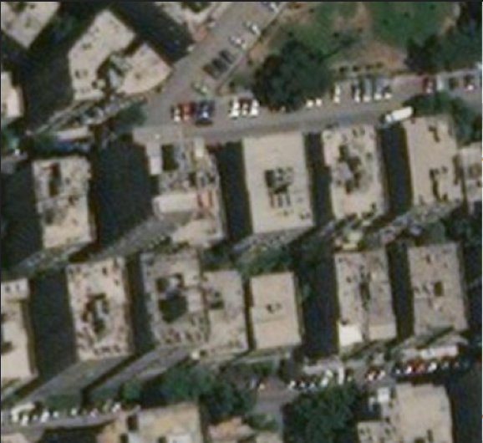
Two components, the generator and the discriminator in ( CGAN ) :
The Generator G need to capture the data distribution .
The discriminator D estimate the probability that a sample comes from the training data rather than from G
Training set
Random noise
Discriminator
Real
Fake
LOSS
Generator
Fake Image

Slide 10
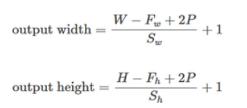
Discriminator
The discriminator in a GAN is simply a classifier. It tries to distinguish real data from the data created by the generator. It could use any network architecture appropriate to the type of data it's classifying.
256 * 256
128 * 128
64 * 64
32 * 32
#F = 64
4*4
P = same
S = 2 *2
16 * 16
#F = 128
4*4
P = same
S = 2 *2
#F = 256
4*4
P = same
S = 2 *2
#F = 512
4*4
P = same
S = 2 *2
#F = 512
4*4
P = same
S = 1 *1
16 * 16
Patch Output
Patch Output
C4
C3
C2
C1
0
(Fake)
1
(Real)
Input

Slide 11
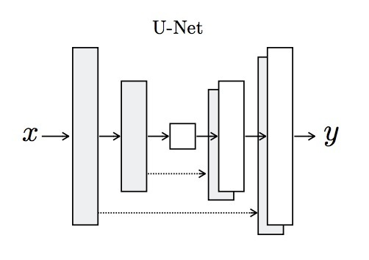
Generator
The generator part of a GAN learns to create fake data by incorporating feedback from the discriminator. It learns to make the discriminator classify its output as real.
Implemented as a U-Net. The U-Net model is an encoder-decoder model for image translation where skip connections are used to connect layers in the encoder with corresponding layers in the decoder that have the same sized feature maps.
Encoder: C64-C128-C256-C512-C512-C512-C512-C512
Decoder: CD512-CD1024-CD1024-C1024-C1024-C512-C256-C128

Slide 12
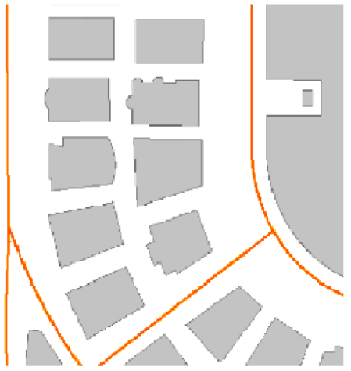
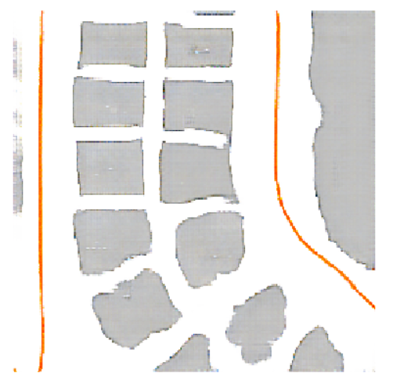
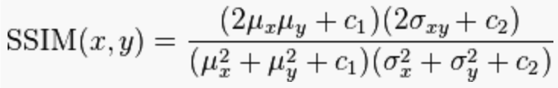
Evaluation
STEP
04
Expected
Generated
Vs
How !
Structural Similarity Index (SSIM)
image classifier that can tell our how similar two images are ? .
0.82

Slide 13
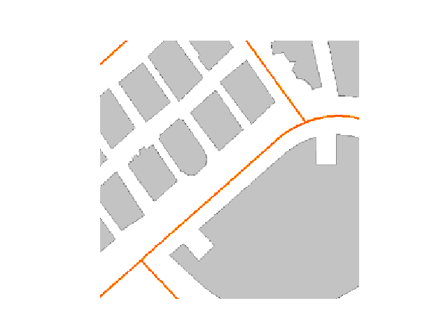
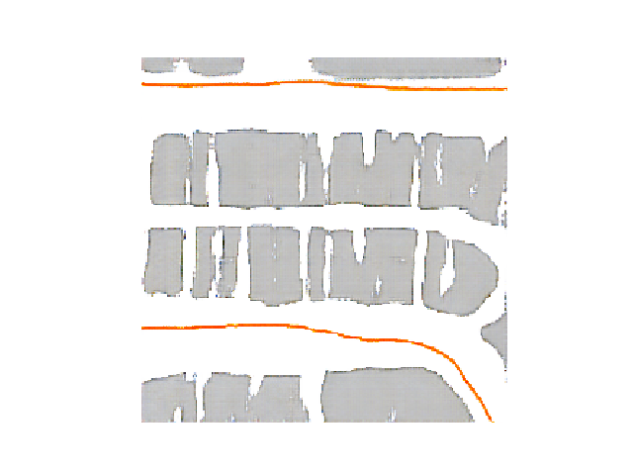
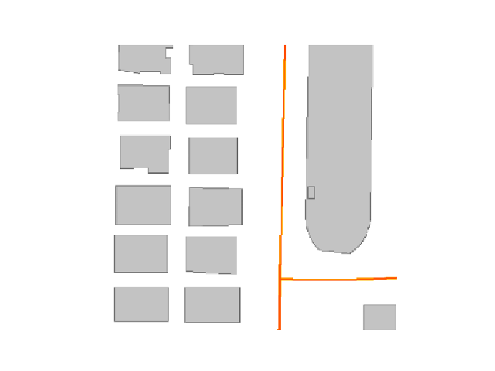

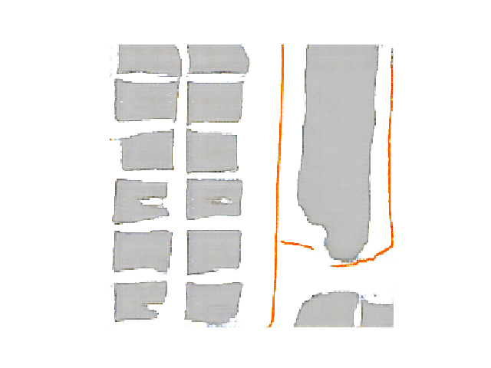
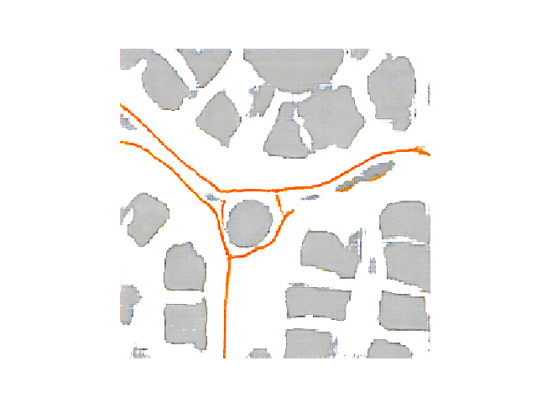
Model Accuracy
Result
81 %

Slide 14
Polygonize
STEP
05

Slide 15
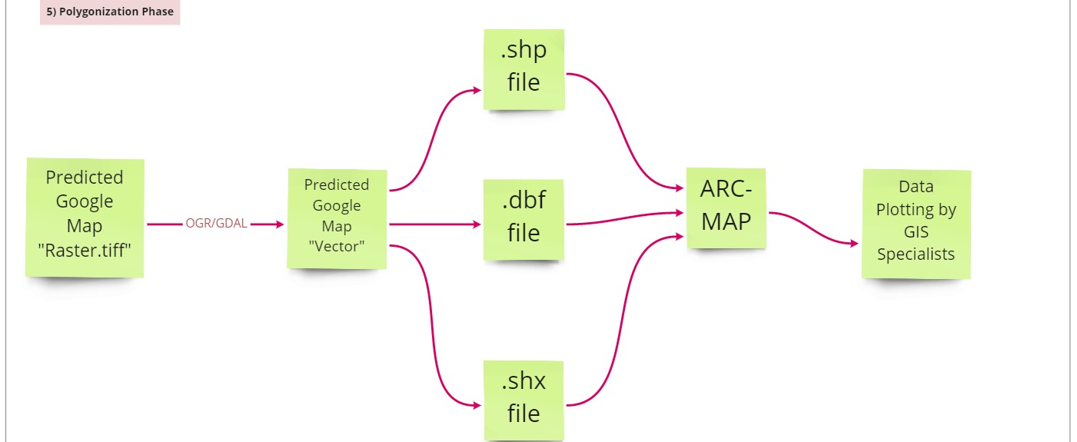
Polygonization steps: 1- Convert Raster to Vector using GDAL 2- Use the three main files generated from the previous operation 3- Fed them into Arc-Map to be plotted by Specialists

Slide 16
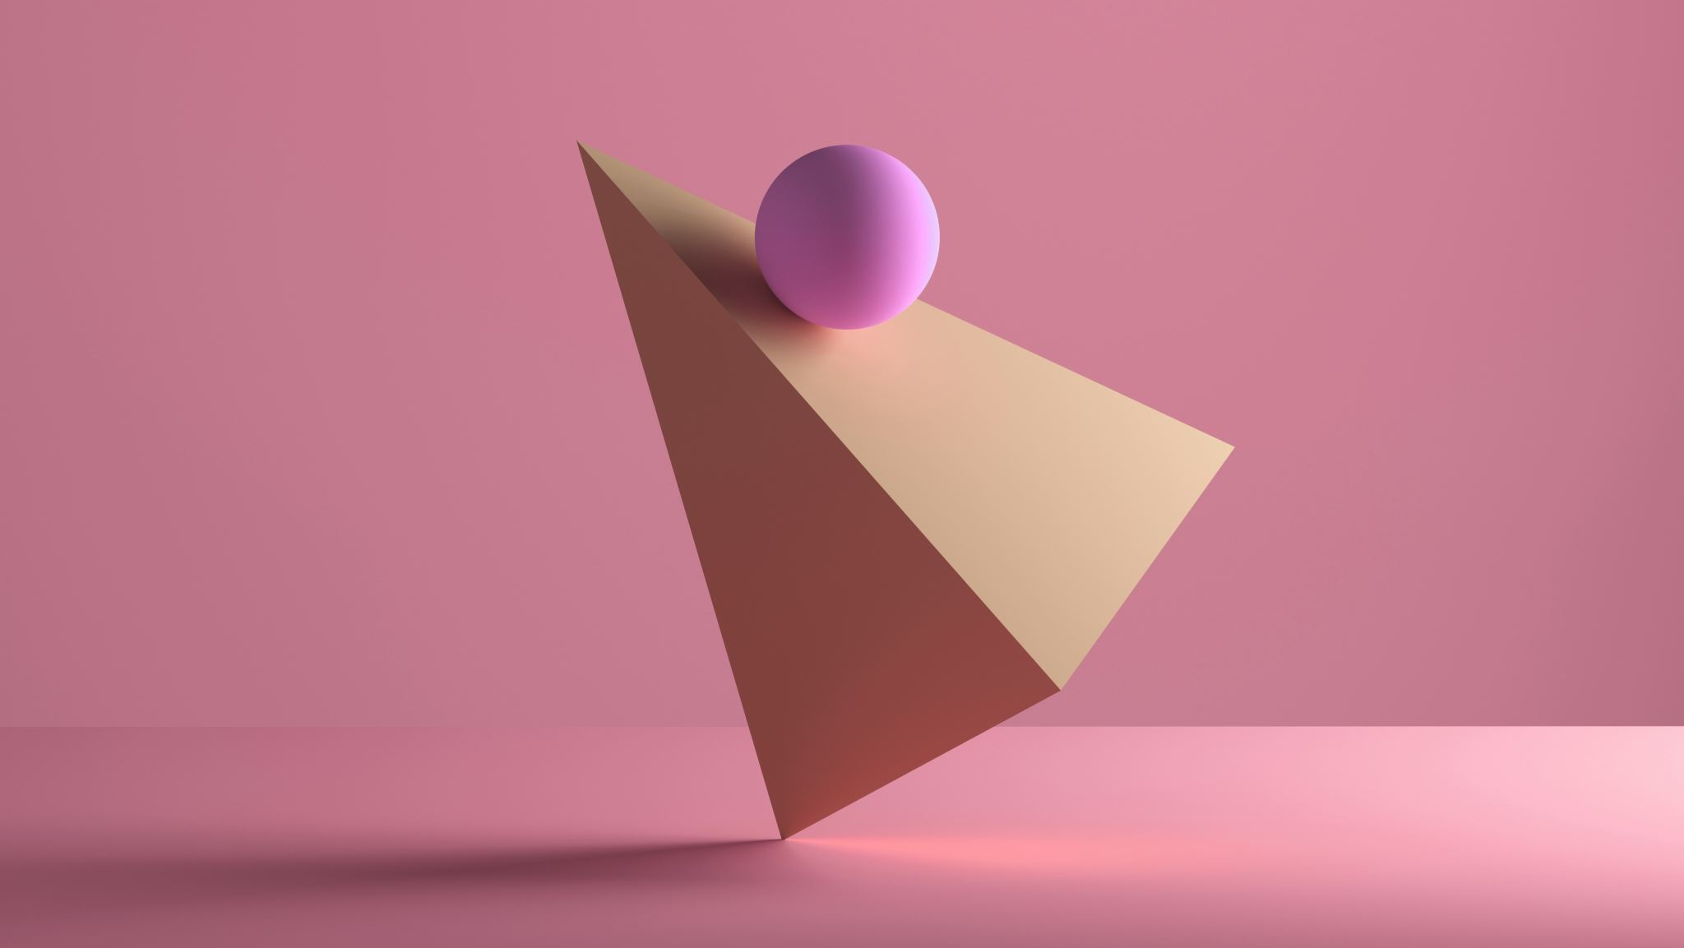
Rasvy App
STEP
06

Slide 17
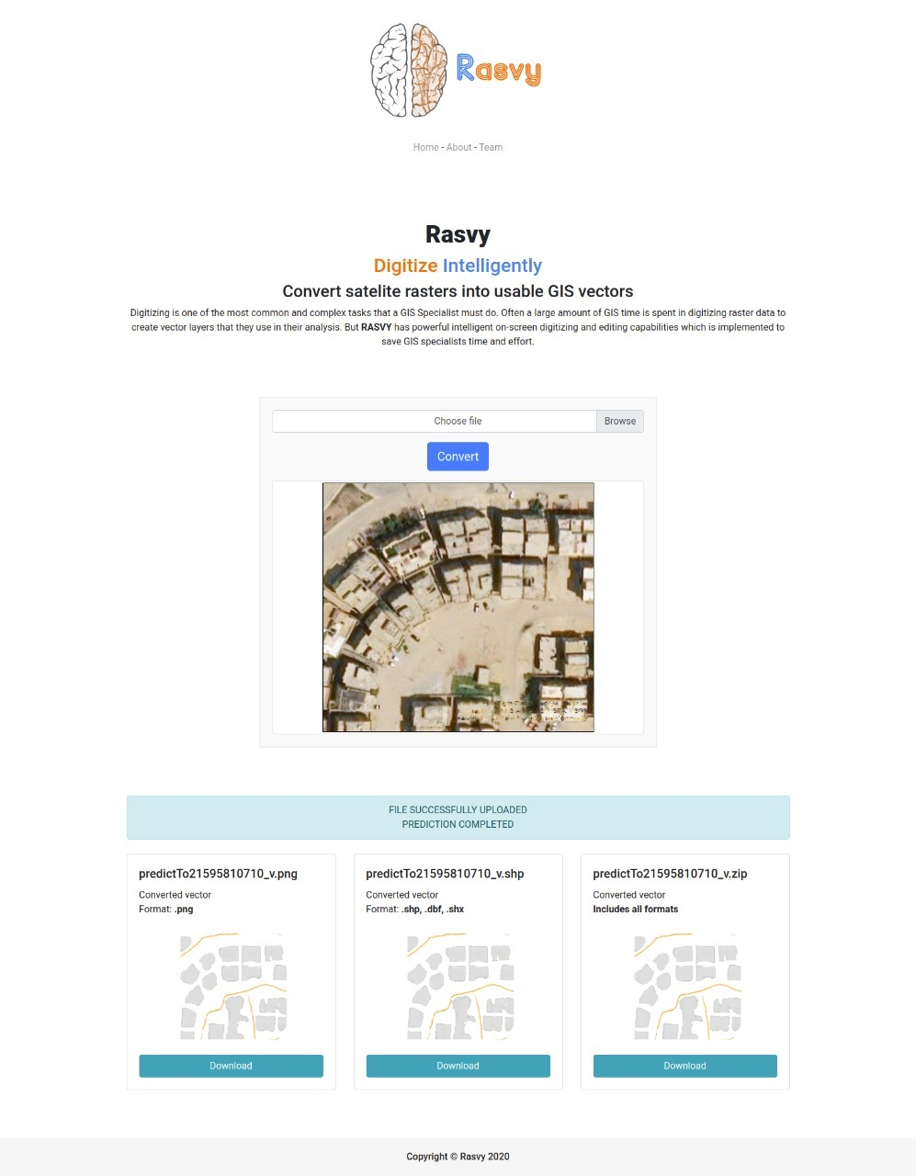
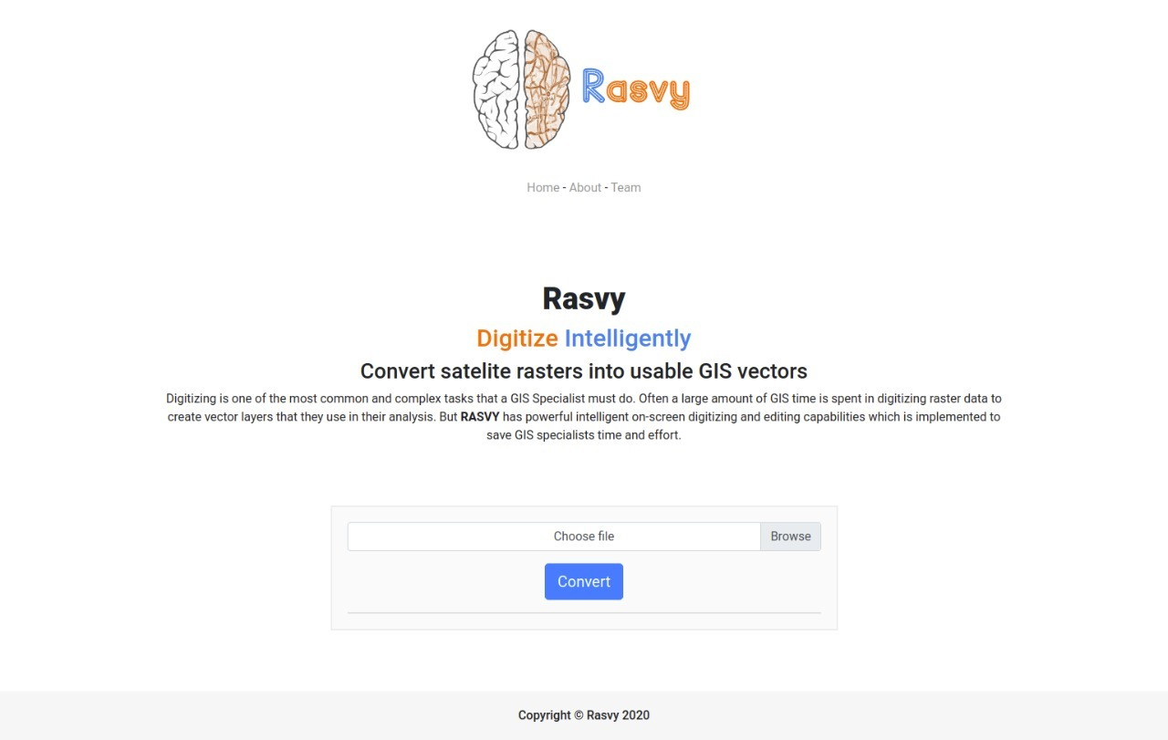
Rasvy UI & UX
http://www.rasvy-app.tk/frontend/

Slide 18
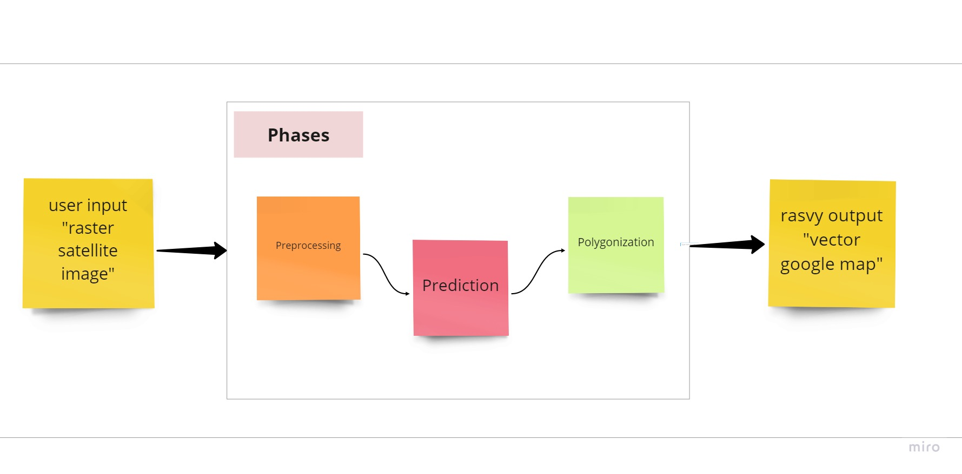
Rasvy Full Process
Backend

Slide 19
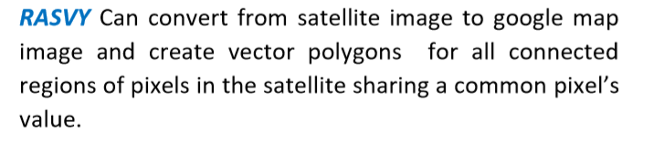
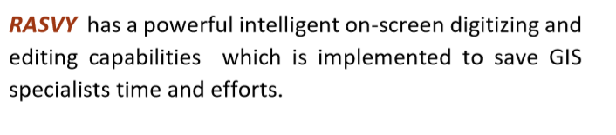
Conclusion

Slide 20
Thank you

